Slide 1
AUC ROC
“Area Under the Curve” (AUC) of the “Receiver Operating Characteristic” (ROC)

Slide 2
AUC-ROC
AUC-ROC curve helps us visualize how well our machine learning classifier performs.
Tt works only for binary classification problems.

Slide 3
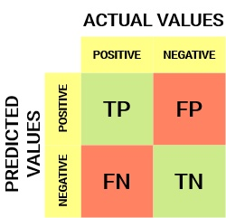


Sensitivity / True Positive Rate / Recall
False Negative Rate

Slide 4


Specificity / True Negative Rate
A higher TNR and a lower FPR are desirable since we want to classify the negative class correctly.

Slide 5
Probability of Predictions
A machine learning classification model can be used to-
Directly predict the data point’s actual class or
Predict its probability of belonging to different classes.
The latter gives us more control over the result.
Setting different thresholds for classifying positive classes for data points will change the Sensitivity and Specificity of the model.
And one of these thresholds will probably give a better result than the others, depending on whether we are aiming to lower the number of False Negatives or False Positives.

Slide 6
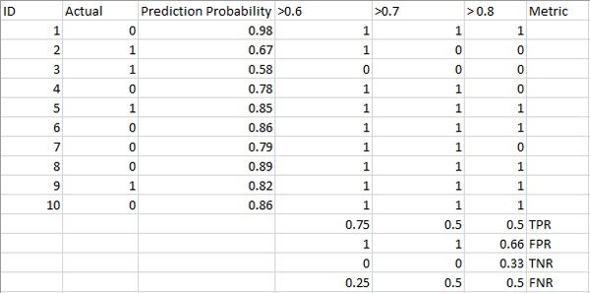

Slide 7
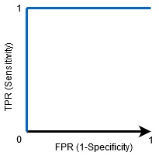
ROC is a probability curve that plots the TPR against FPR at various threshold values.
The Area Under the Curve (AUC) is the measure of the ability of a binary classifier to distinguish between classes and is used as a summary of the ROC curve.
The higher the AUC, the better the model’s performance at distinguishing between the positive and negative classes.

